Slide 1


State Space Models 101
Shubham Gupta
in/shubhamgupta2208 shubhamg.in
Notes:
Hello!
My name’s Shubham Gupta, and this talk aims to cover State Space Models.
I’m currently a software Engineer at Temus.
I’m originally from Bangalore, India and I moved to Singapore in late 2019
I’ve primarily worked at startups, with my focus being data engineering and machine learning.
Before we dive into SSMs, we’ll do a quick recap of some concepts.

Slide 2


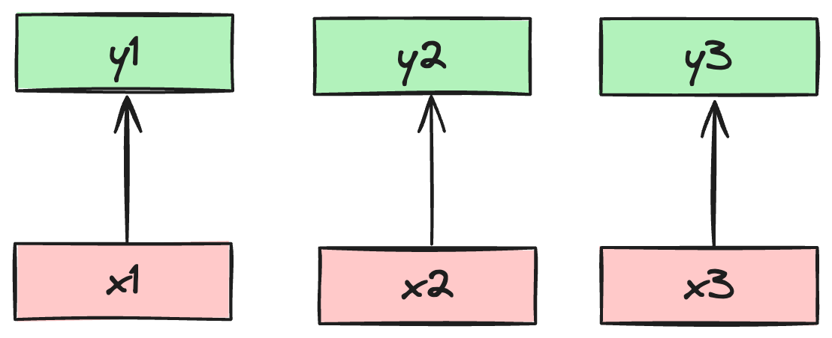
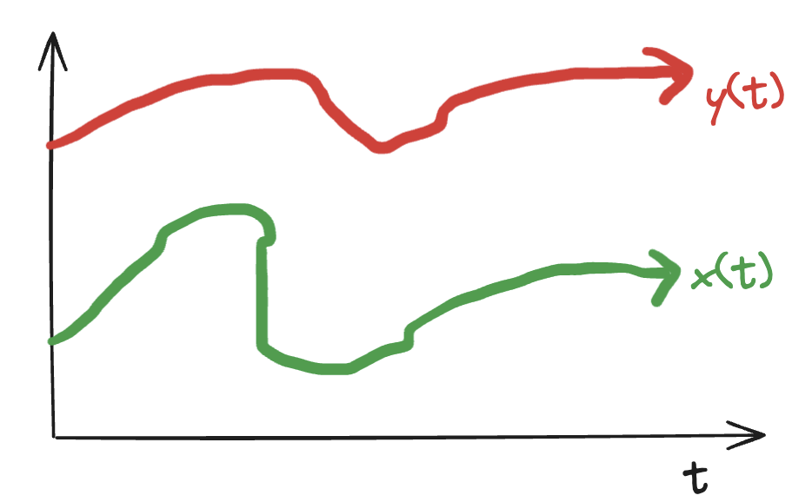
Sequence Modelling: Recap
Goal: Map an input sequence to an output sequence
Notes:
The goal of sequence modelling: Map an input sequence to an output sequence
We can map a discrete input sequence x(t) to a discrete output sequence y(t), or a continuous sequence x(t) to a continuous output sequence y(t).
Discrete sequences can be counted and measured separately, such as words in a sentence.
Continuous sequences change with time. Eg: Audio signals, DNA, etc.

Slide 3
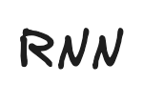
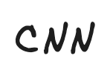
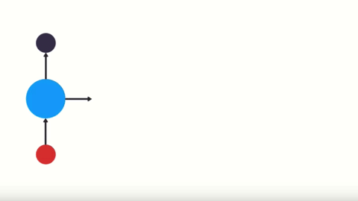
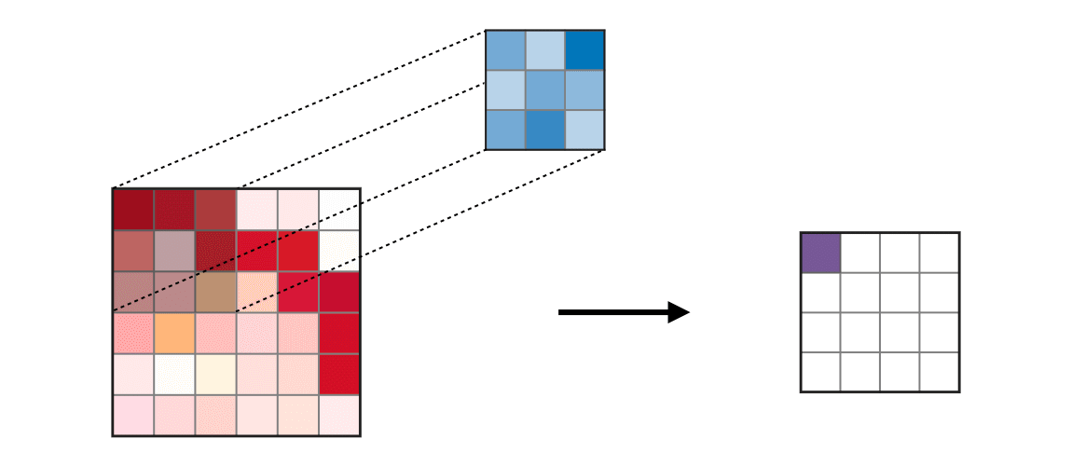

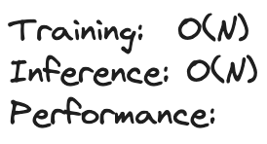
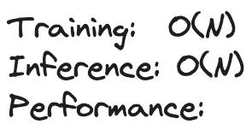
Sequence Modelling: Models
⫲
😊
∥
👎
😊
😊
☹️
☹️
Notes:
RNN:
They have a training runtime complexity of O(N), where N is the seq length. However, the training is not parallizable.
RNN’s have a runtime complexity of O(N) i.e it scales linearly with the length of the sequence. They also require constant memory during inference. This is because the next output only depends on the current input and the current hidden state.
While theoretically RNN have infinite context length, they suffer from vanishing gradient problem. Hence, they have poor performance.
CNN:
Both training and inference depend on the kernel size K, which goes over N pixels of the image.
Training and inference is easily parallelizable in CNN.
However, we still need to materialize(explicitly init and allocate values) the kernel K before running the operation.
They also have fixed input length, which restricts the size of the sequences they can process.

Slide 4
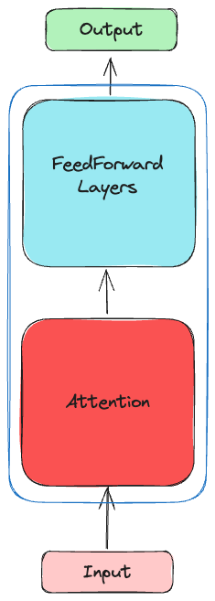

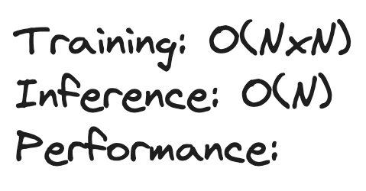
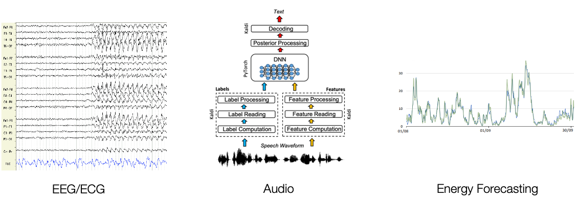
Sequence Modelling: Transformers
SoTA on sequence modelling tasks
Struggle to scale over long sequences
Why do we care?
Enable new capabilities
Model other sequential data
😐
😊
💪
Notes:
Transformers are the current SoTA on sequence modelling tasks.
They consist of 2 key modules: The attention mechanism and the feed-forward layer. These modules are repeated H-times in the network to form the “H-heads”, which give the model it’s expressivity power.
Transformers training time scales quadratically with length of sequence `N`, due to the attention mechanism which needs access to all tokens in the input. However. Training transformers efficient since the process is paralleizable
Inference in transformers scales linearly with sequence length, assuming you are using the KV cache to compute the dot product. Eg: for 10 tokens, you would need to perform 10 dot products to get the output. For 11 tokens, 11 dot products, etc.
Training complexity is a problem when the we deal with large sequences, especially sequences greater than 10k steps
Long dependencies needed to:
Enable New Capabilities
Summarization, understand books, codebases
Model other sequential data
DNA, Time-series, Video, Robotics
They inherently have a notion of time in the dataset.
We will call this “signal” data, as compared to text which we usually call “sequence” data.

Slide 5

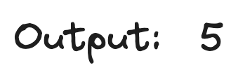

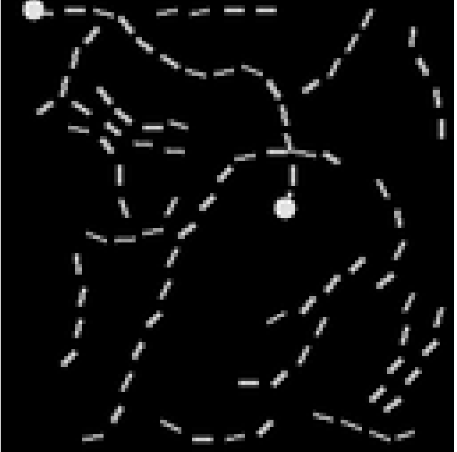
Long Range Arena Benchmark
LRA [Yi Tay et al., 2020]
Measure long-context model quality
Multiple input modalities
Total tasks: 6
Input sequence length: 1k-16k
Transformer Performance:
Avg. Accuracy: 52% 👎
Unable to solve Path-X
Notes:
LRA: Long Range Arena Benchmark
Developed by reserachers at Google (Yi Tay) in 2020,
Aims to evaluate model quality over long-context scenarios
It has tasks which contain data in multiple input modalities such as text and images
It contains a total of 6 tasks with input lengths ranging from 1k-16k tokens
ListOps is the task of evaluating a long mathematical expression.
Long ListOps is an extension of ListOps with max sequence length: 2k
Path-Finding: Find if there is a path between the two dots shown
Path-X: Harder version of Path-Finding. Check if model can find a connected path on images with 16k pixels.
Transformers perform poorly on the LRA benchmark, with an average accuracy around 52%.
Transformer models were completely unable to solve Path-X task

Slide 6

Obtain best of all models for long-context?
😊
∥
😊
💪
Notes:
Can we get a model that has:
Linear scaling during both training and inference
Parallelizable training and inference process
Performance that matches transformers
Generic architecture that can process data in multiple format(text, audio, video)

Slide 7
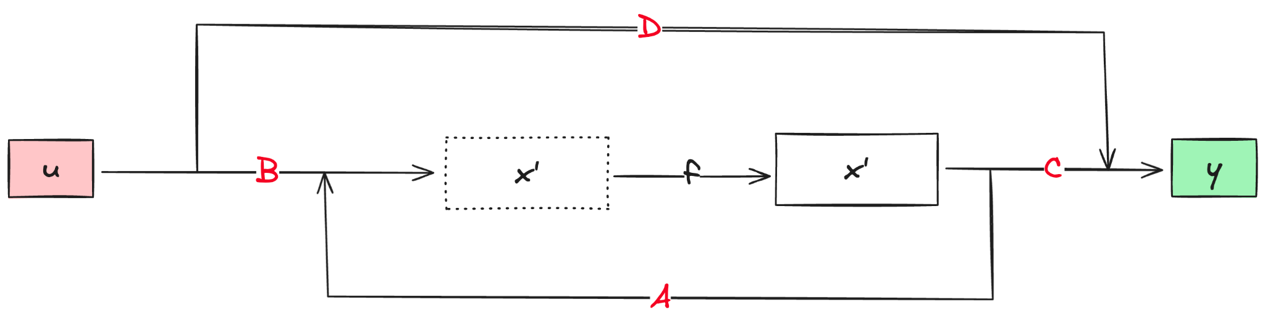
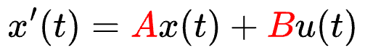
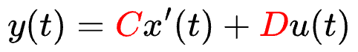
State Space Models
Kalman, 1960
Used in control theory/signal processing
Modelled as continuous-timed differential equation
1-layer, Linear Model
Time - Invariant
Notes:
SSMs are classically a statistical model
They’ve been around since the 1960s
They are modelled as a continuous-timed differential equation i.e they Model the small change in hidden-state over time.
They are represented using the 2 equations shown here.
SSMs are a 1-layer, linear model
They are also time-invariant. The parameters A,B,C and D are fixed for all inputs, and are learning during training.
An easy way to think about this models is:
First we project input “u” to a higher dimensional space(or latent space) “x”
We then project back from the higher dim space to the output “y”

Slide 8
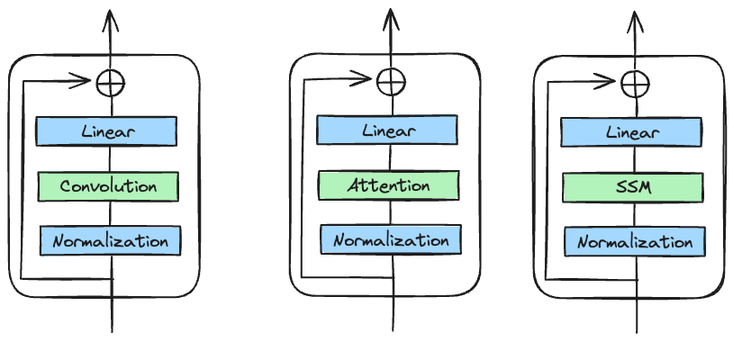
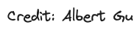
Deep SSMs
Deep, non-linear model
Deterministic transformation
Notes:
Think of SSM in a deep learning sense
They are just a deterministic feature transformation
Convolution can be thought of as a feature extraction
Difficult parts of deep learning
How to compute efficiently?
How to do backprop efficiently?
How to define the model such that we can extract meaningful features?
We aim to simply use SSMs are a “blackbox” model, where the parameters A,B,C,D are learned via gradient descent.
For now, we will focus on ONLY replacing the quadratic computation of transformers i.e the attention layer. We’ll continue to use all the other components of the transformer.

Slide 9
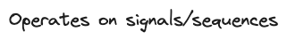
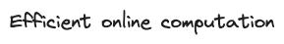
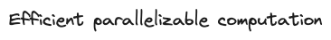
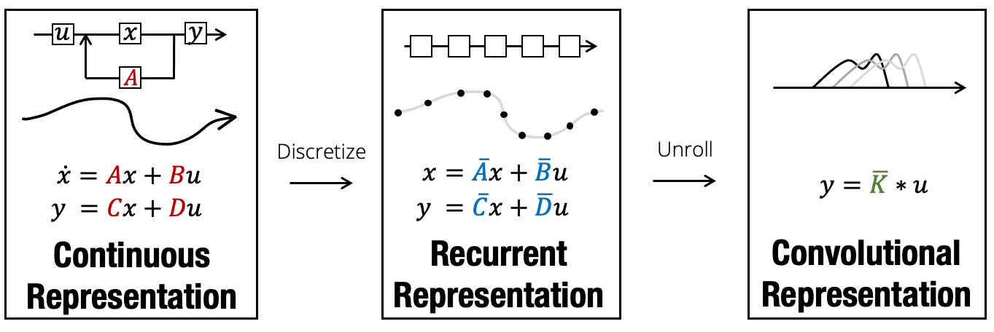
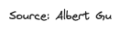
SSM Properties
Notes:
SSMs have nice properties suitable for deep learning. They can be represented as a:
Continuous representation
Operates primarily on signals and sequences
Recurrent representation
This form allows efficient online computation, since the output at the current timestep will only depend on parameters from the previous timestamp and the current input
Convolutional representation
Allows us the represent the equations as a kernel K, which we can use to perform a convolution operation on the input

Slide 10
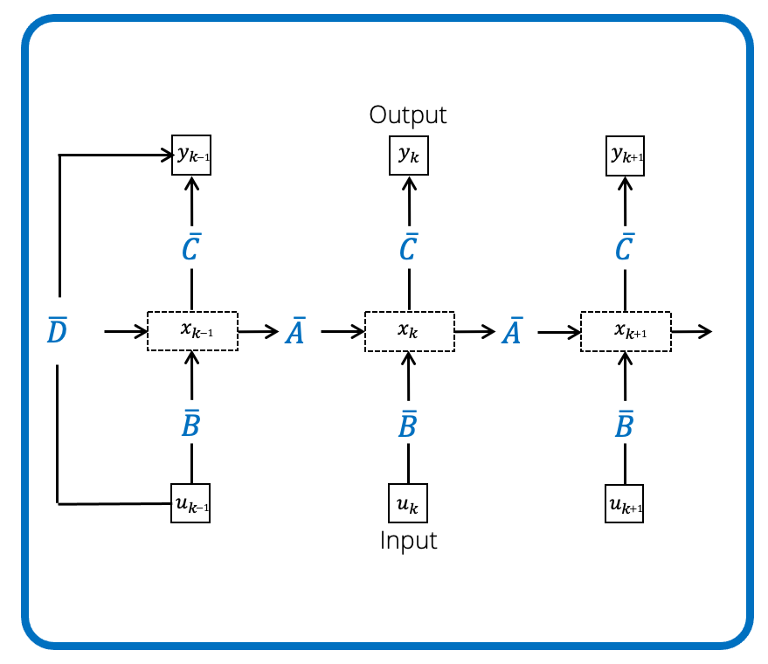
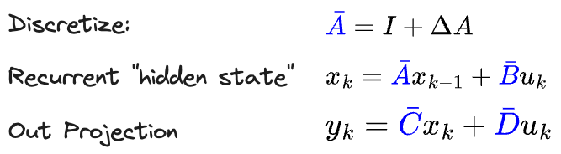

SSM: Recurrent
Notes:
The recurrent formulation is used when we want to work on sequences instead of functions. Eg: Sequence modelling
This is derived from the continuous formulation.
It is used to answer the question: Given the formula, how can we determine the state at time = t?
Discretization: Convert from continuous time to discrete time. This is arguably the most important step of SSMs.
Aim: Find value of function at certain timesteps, instead of all timesteps, and generalize..
There are many standard techniques to perform discretization. You can think of them as blackbox functions
Delta refers to the “step size”. Smaller the step size => Better the approximation
Based on the method of discretization used, you will get a different output for the matrix A_bar.
The method used here is the Euler Method.
Alternatives are Zero Order Hold(ZOH) or the Bilinear Transform
After performing the discretization step, we get the formula for generating the hidden state recursively, which can in-turn be substituted in the 2nd equation to get the output.
The current hidden state depends on the previous hidden state and the input
The discrete version of the SSM is a linear recurrence, or also a Linear RNN. We can unroll the recurrent formula to get the flow shown in the image.
This form is great for inference, as it can compute one token at a time with constant memory, and will scale linearly with the size of the input sequence

Slide 11
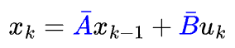
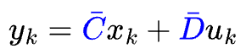
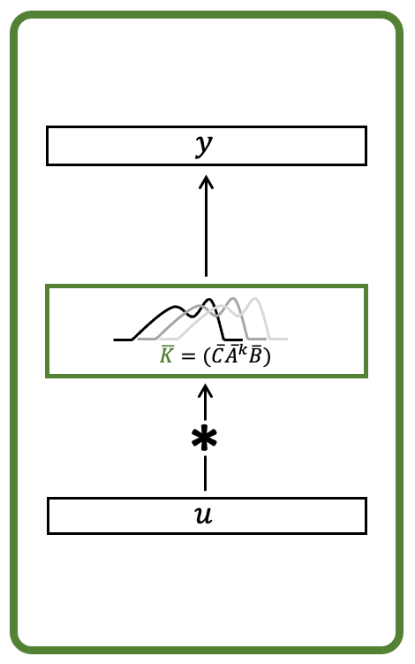

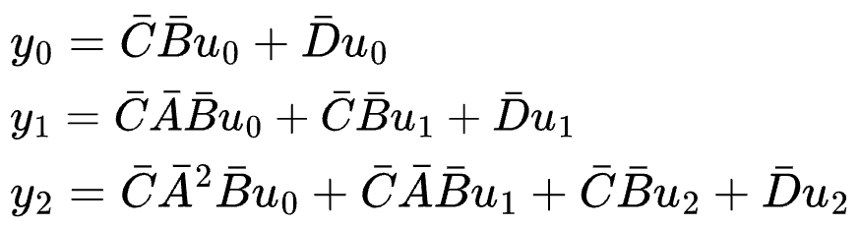
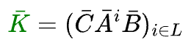
SSM: Convolutional
Notes:
The convolutional representation is directly derived from the recurrent representation
Given the recurrent form, we essentially expand the terms one by one.
Assuming a initial hidden state of 0, we get the value for x_0, which can be substituted back into the equation to get the value of x_1, x_2, etc.
Given the hidden state values, we can then substitute them into the 2nd equation to get the output values.

Slide 12
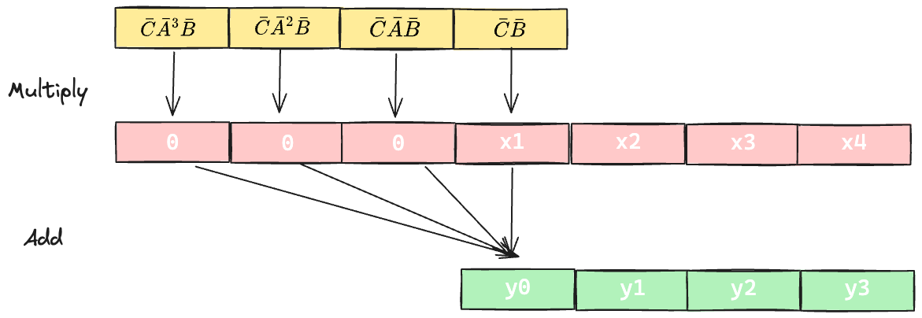
SSM: Convolutional Kernel

Slide 13
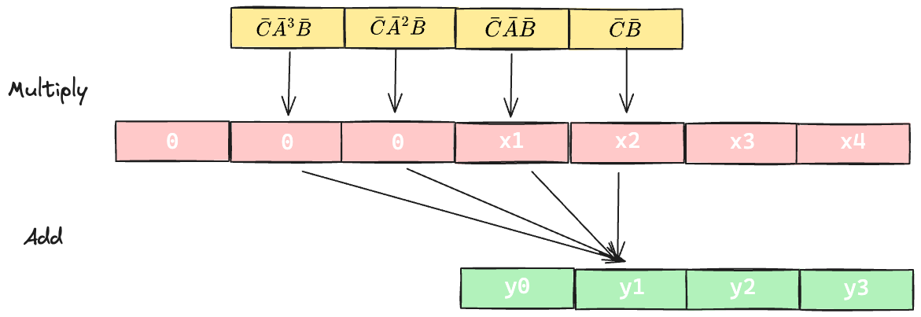
SSM: Convolutional Kernel

Slide 14
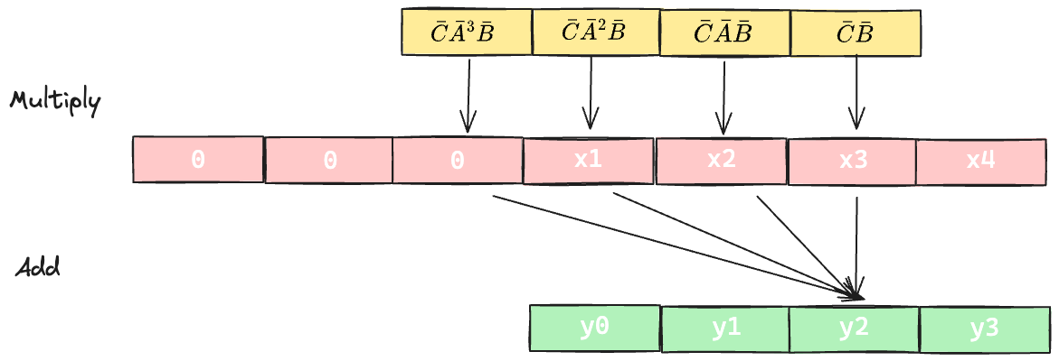
SSM: Convolutional Kernel

Slide 15
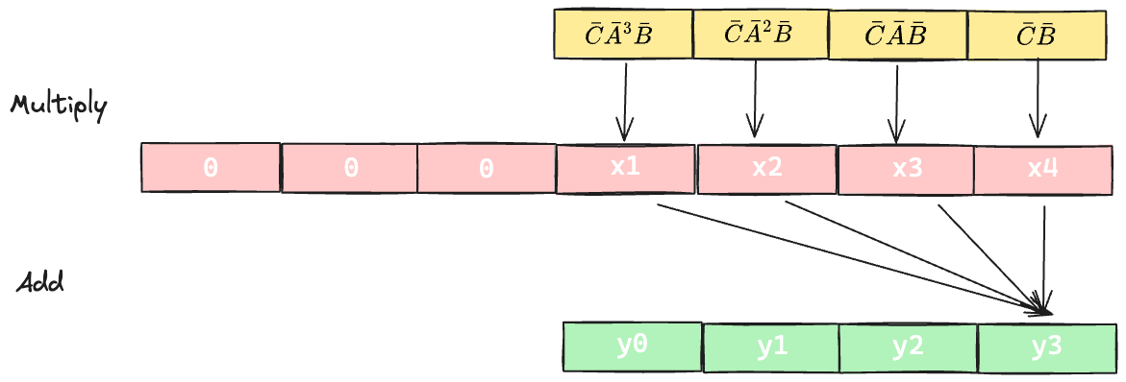
SSM: Convolutional Kernel

Slide 16
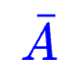
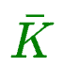
Deep SSM: Challenges
Modelling Challenge
SSMs inherit problems of CNN,RNN on LRA
Random init A
60% acc sequential MNIST 🙁
Computation Challenge
SSM has nice properties if and are known
Computing them is hard!
Computing the Kernel
A power 🔼-> vanishing gradient?
A power 🔼-> O(D²N) computation
Ideal -> O(N)
Notes:
Deep SSM has two main problems:
Modelling Challenge
They inherit the problems of CNN and RNNs, and don’t actually work well on long context.
The A_bar matrix is an important parameter because it controls the state dynamics.
Randomly initializing the A matrix leads to only 60% accuracy on the sequential MNST classification task
Computation Challenge:
There’s 3 representations of the SSM, which gives it nice properties
However actually computing them is feasible, BUT very slow
As the power of the A matrix increases, we run into the same problems as the RNN i.e vanishing gradient
As the power of the A matrix increases, and the size of the state space increases(D), we need to do a lot more computation to save the state
Sequence Length -> N
State Size -> D

Slide 17

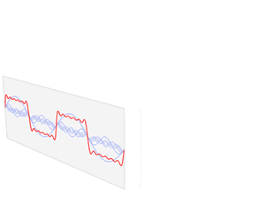
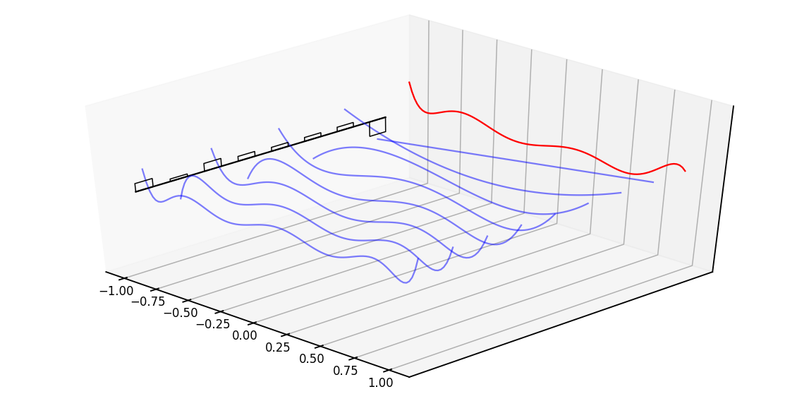
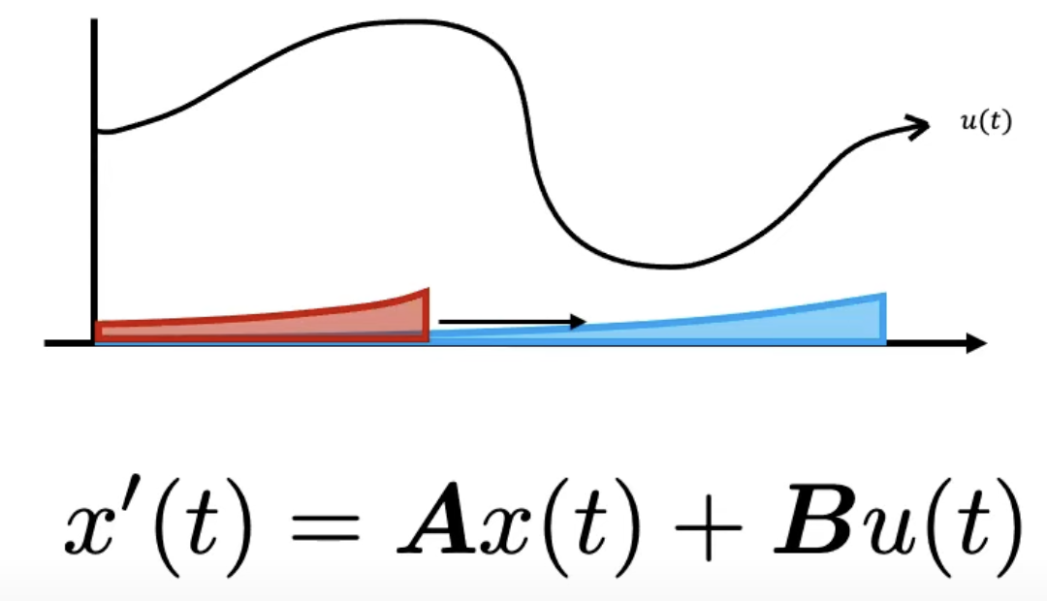
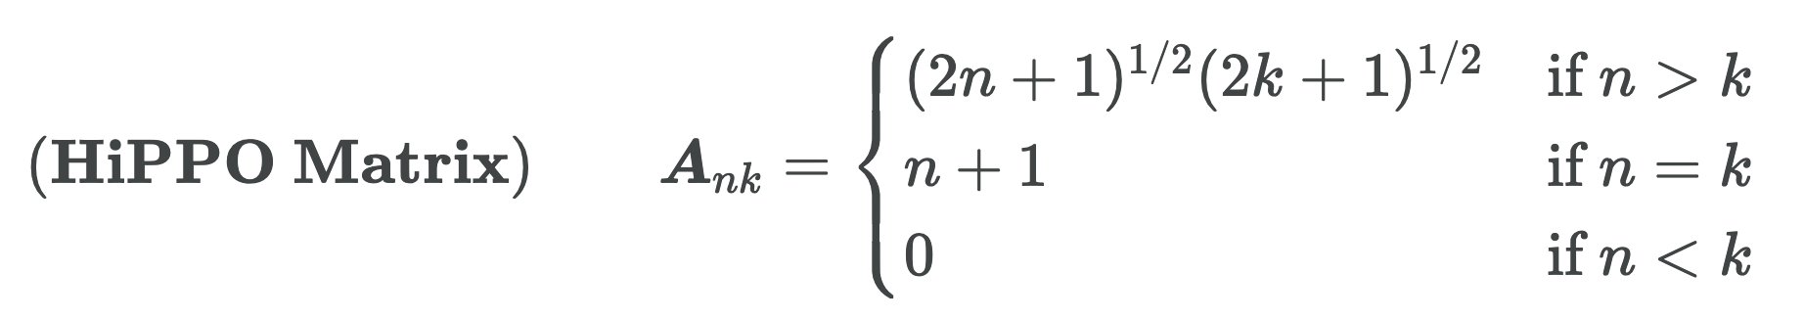




S4: Structured SSM
➕
➕
Notes:
The basic SSM randomly performs very poorly in practice. This could because it suffers from gradients scaling exponentially as the sequence length increases(vanishing/exploding gradients problem)
Based on the SSM equation, the matrix A :
captures information from the previous state that is used to build the current state
decides how this information is copied forward in time
HiPPO Matrix:
The name is derived from Hippocampus: part of the brain response for memory.
Background from Fourier Transformers:
Fourier transforms allow decomposing a signal into a series of sinusoidal functions such that the sum of these functions will rebuild the original signal
FFT aims to rebuild the original signal exactly
HiPPo matrices on the other hand use legendre polynomials instead of sinusoidal functions. It aims to build the most recent
HiPPO
Stands for: High Order Polynomial Projection Operator
is used to initialize the matrix A
Aim:
Compress the past history into a state that has enough information to approximately reconstruct the history.
In the image, the red signal is the one we want to approximate, and the black lines represent the legendre coefficents.
Intuition
The matrix A represents learned coefficients
Instead of having FFT coefficients, it will instead have the coefficients for the legendre polynomial
Using
The matrix is obtained can improve the performance of SSM on SEQUENTIAL MNIST classification from 60% to 98%.
Finally, structured matrices just breaks down the A matrix into specialized matrices which have better properties for training, and are easier to compute for the convolutional kernel.

Slide 18
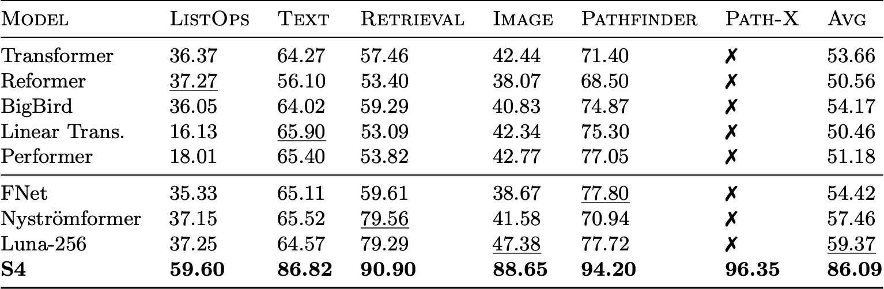
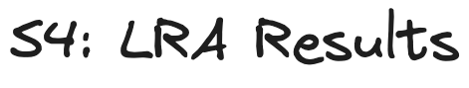
S4: LRA Results
Notes:
Based on the above blocks, the S4 model is trained.
We see that S4 demonstrates great performance on the LRA benchmark, and is the first model to solve the Path-X task
The model also works extremely well on image and audio signal datasets.

Slide 19
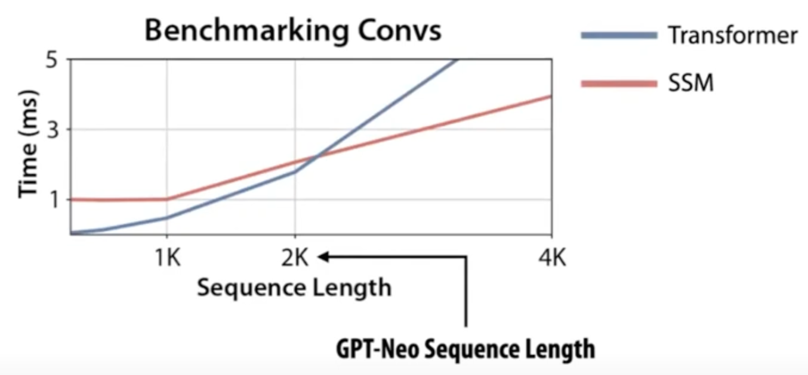

S4: Problems
Language Modelling
Short Sequence Efficiency
Model | PPL(OWT)
Transformer | 20.6
S4D | 24.9
GSS | 24.0
Notes:
S4 models have two main problems: Performance on language-modelling tasks and efficiency on short-sequences
Language Modelling
While S4 does well on long-context tasks over audio and images, it still lags behind transformers on the language modelling task.
Specifically, variants of the SSM model (S4D, GSS) are almost 5 perplexity points worse than transformers of a similar size on the OpenWebText(owt) dataset.
This is the performance difference between a 125M parameter transformers and a 6.7B parameter transformer
Short Sequence Efficiency:
The time taken to train SSMs on short sequences(under 2k) is longer than the time required by transformers.
Before we look at a series of models that aim to address these shortcomings, we need to briefly talk about GPU memory

Slide 20
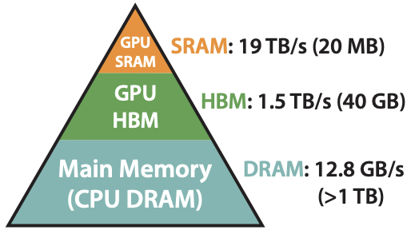
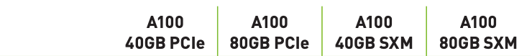
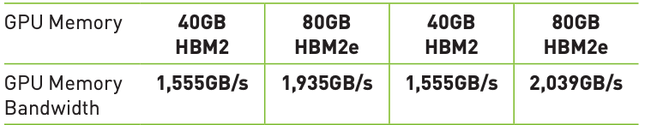
Background: GPU Memory
Components:
DRAM
HBM
SRAM
Problems:
Size
Speed
Optimizations:
Kernel Fusion
Recomputation
Parallelism
Notes:
HBM: High Bandwidth memory. Output of the command `nvidia-smi`
GPU SRAM: Static Random access memory ram. This is closest to the GPU compute units, making computations in SRAM an order of magnitude faster than the HBM
Main difference between GPUs
Size of the HBM
IO speed(bandwidth) between HBM and SRAM
Key takeaway:
SRAM is faster than HBM
Moving data between HBM and SRAM is really expensive
Most memory efficient algorithms include a combination of the following optimizations:
Kernel Fusion
Recomputation
Parallelism
Let’s explore them. We start with kernel fusion

Slide 21
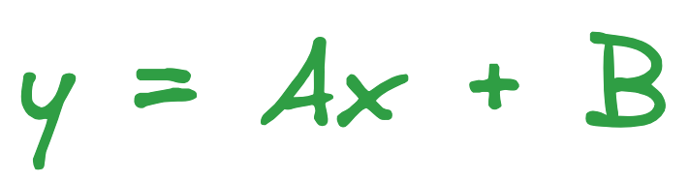
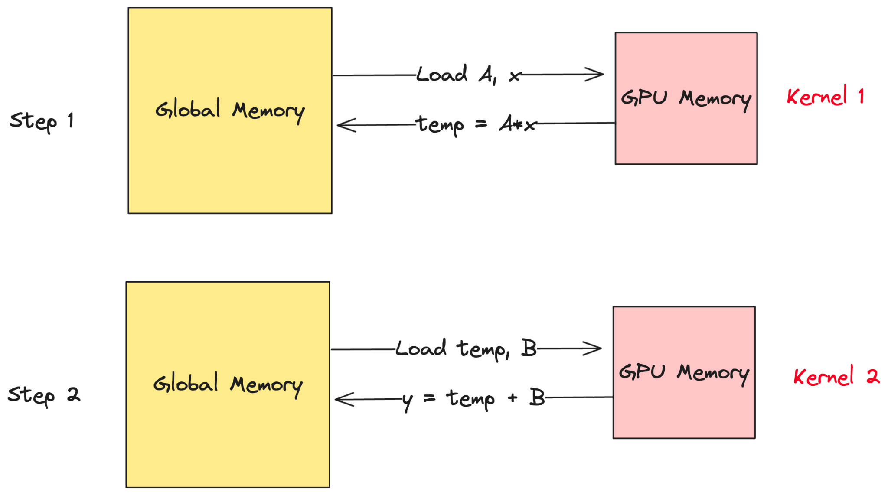
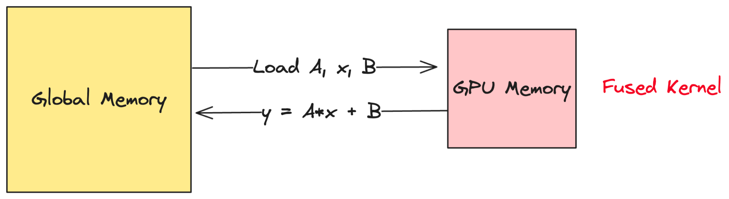
GPU: Kernel Fusion
Notes:
Say you need to compute the expression y = Ax+b, where A, x and B are tensors
In the naïve implementation we would first:
Copy A and x from HBM to SRAM, perform the computation
Copy result back to global memory
Then we would:
Copy the temp variable and B back into GPU memory, perform the computation
Return the result
The main problems here are:
We are moving data between HBM and SRAM multiple times, causing IO that is slower than compute speed
We are also storing intermediate values, which occupy memory but are not really used after this computation
Instead, Kernel Fusion aims to:
Combine similar operations in a single operation. It will load A, x and B in one operation to SRAM, and compute the result using a single operation
This is called fused-add-multiply
It also avoids moving data multiple times between HBM and SRAM, and storing intermediate values, thereby making the entire computation a order of magnitude faster.

Slide 22
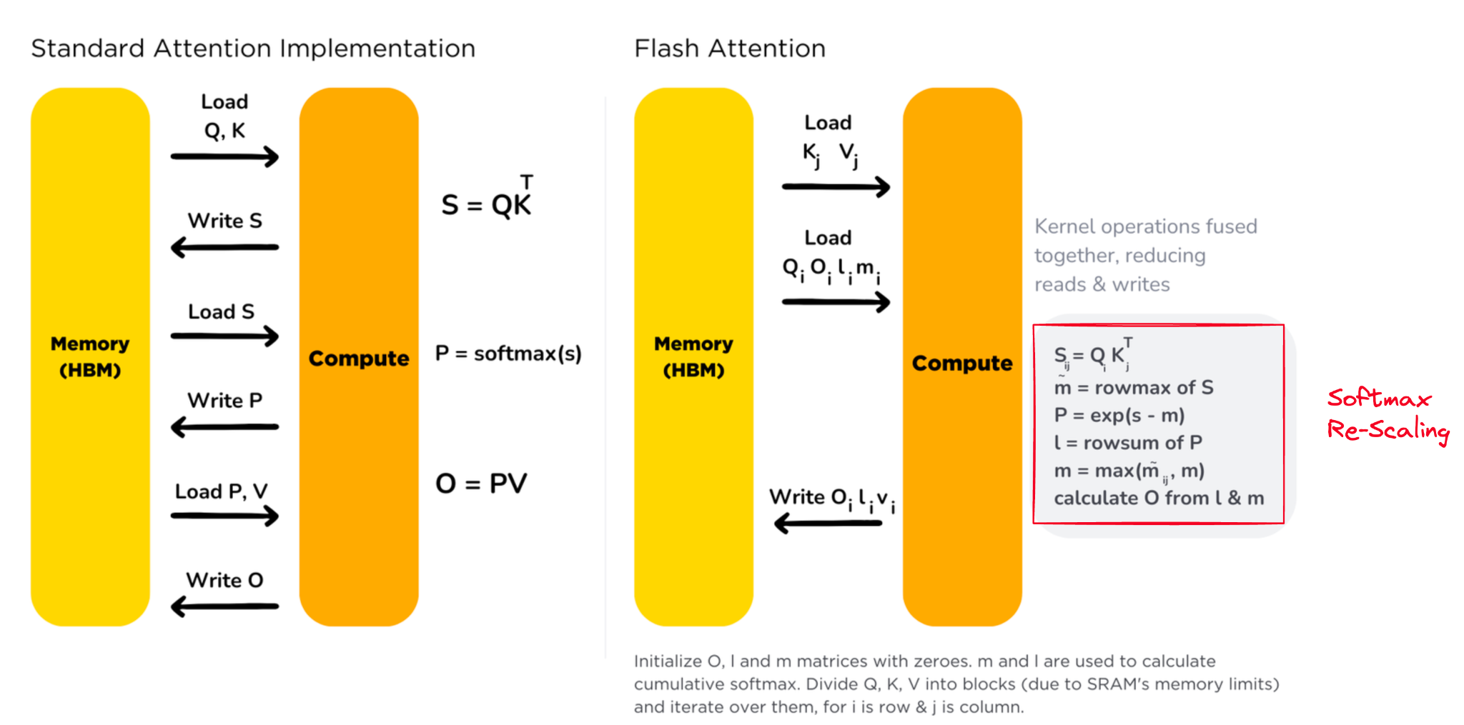


Flash Attention: Kernel Fusion
Notes:
The most popular method for computing the attention matrix is FlashAttention, and internally it also uses the Kernel Fusion trick.
Recall that the attention formula contains a softmax term over the query and key matrices, which are the added to the “value” matrix
Naive Attention
Move data multiple times between HBM and SRAM
Slow
Flash Attention:
Use kernel fusion to compute multiple operations in one go
Split the input key and query matrices into blocks, compute intermediate results and add them to the value matrices to get a intermediate output.
You might ask: The softmax operation cannot be done in parallel, since it outputs a distribution OVER ALL CLASSES.
This is solved using the Softmax Rescaling trick, as shown in the image.
Diving deep into the softmax-rescaling part now

Slide 23


Flash Attention: Implementation
Notes:
Here, we demonstrate how the scaled attention is computed
First, we divide the key and into blocks, and compute their results in parallel
We add the intermediate softmax values to get L_1 and L2
Finally, after multiplying the data with the value matrix blocks, we scale the output based on a normalizing factor.
A paper from 2019 showed that doing this operation gives the exact same result as doing softmax over all classes.
In Summary, flash attention does the following:
Break input down into blocks and process them in parallel
Recomputation:
Instead of saving intermediate values for backprop, we just recomputes the activations in SRAM again, as this is faster than moving data from HBM to SRAM
Combine common operations in a single specialized kernel using kernel fusion
These are the main reason why flash attention is:
Fast
But also Exact!
---------------------------------------------------------------------------------------------------------------------------
Recomputation
we avoid saving the intermediate states, which are necessary for backpropagation.
Apply recomputation to reduce the memory requirements:
the intermediate states are not stored but recomputed in the backward pass when the inputs are loaded from HBM to SRAM

Slide 24




Hungry-Hungry HiPPOs (H3)
Improve SSM on synthetic tasks
Combine two SSMs in a single network
Replaces all Transformer layers, except two
Trained using FlashConv + Fusion
Notes:
Aims to improve the performance of SSMs on synthetic tasks
Induction Head: Mimics language i.e in-context learning. Recall information from earlier in the sentence.
Associative Recall: Dummy language that contains a list of key and values. The goal is to recall the value given a key
The reason for selecting these tasks is:
It mimics real-life language modelling settings
It is easy to benchmark new architectures without expensive infrastructure
Two SSMs => that’s why the paper is called “Hungry-Hungry” and just a single “Hungry”
First SSM:
Performs token comparison nearby in the sequence. Think of this as a convolution over the input sequence
Init it to just remember the previous token and spit it out in the next step
Second SSM:
Performs the function of “memory” i.e remembering words from the entire sequence.
Multiply the outputs of both SSMs to get the best of both SSMs. Also called “multiplicative gate”
Replaces all transformer layers, except two
It is trained using FlashConvolution, which is an efficient way of performing convolutions on GPU, using the same ideas as shown in FlashAttention

Slide 25

H3: Results
Language Modelling
Model | PPL(OWT)
Transformer | 20.6
S4D | 24.9
GSS | 24.0
H3 | 21.0
H3 (with two attention blocks) | 19.6

Slide 26

H3: Scaling Results

Slide 27






S4: Additional Problems
Notes:
Problems with S4:
S4 fails at a few key tasks: Copying, Selective Copying and the induction heads task
Copying:
Constant spacing between input and output elements
This is easily solved by time-invariant models such as linear recurrences and global convolutions.
Reason: Think of CNN’s like “stamping” and RNN’s like copying letter by letter(which will fail as the length of the sentence being copied increases)
Example of this task: Rewrite input to output one token at a time, but time shifted
Selective Copying:
Random spacing in between inputs requires models that can “selectively” ignore inputs depending on their content.
Another example:
Given a comment, rewrite it by filtering certain words.
Induction Heads:
Induction heads task requires retrieving an answer based on context, which is a key task for LLMs. This is also called “In-Context” learning
In this task, model needs to recall information from previous inputs to build the current input.
Eg: ‘Few shot examples’ for new tasks. This is easy for the transformer since it can attend to previous tokens while generating the current token
S4 fails at these tasks because the parameters A,B,C are independent of input “u”
“Dynamic” inference is not possible
Convolutional View:
Global convolutions can solve copying tasks because it only requires time-awareness, but they have difficulty with selective copying because they lack “content awareness”

Slide 28

Mamba(S6): Selective SSM
SSSSSS…🐍
Improves SSM performance on copying tasks
Handles input data that is varying in time
Only supports recurrent form
➕
➕

Slide 29

Mamba: Architecture
Notes:
Mamba combines the H3 block, which is the basis of most SSM architectures, with the ubiquitous MLP block of modern neural networks.
Instead of interleaving these two blocks, we simply repeat the Mamba block homogeneously.
Compared to the H3 block, Mamba replaces the first multiplicative gate with an activation function(called the Swish activation function, or SwiGLU activation function)
Compared to the MLP block, Mamba adds an SSM to the main branch

Slide 30




Mamba: Implementation
Notes:
Algorithm 1 represents the S4 implementation
Algorithm 2 represents the proposed mamba implementation
We have
Batch ‘B’ of prompts
Each prompt made up of ‘L’ tokens
Each token has ‘D’ dimensions
In S4, we let the model learn the discretization parameter \delta
In Mamba:
Key changes:
Make all parameters(B, C, \delta) dependent on the input i.e these parameters will change will the input. In the model, these are just linear layers.
The linear layer increases the dimensionality of the input token. Gives the model more power to make some inseparable classes in low dim separable in high dimension
The A matrix also depends on the input indirectly, through delta(See line 5 in algorithm 2)
Importantly, now since the parameters A,B,C,D dependent on the input, we can no-longer precompute the convolutional kernel used in training. The mamba architecture only supports the recurrent form
This is a problem, since we’re now back to the same spot as we were in with RNNs
However, the authors offer a different perspective of looking at the recurrence relation.

Slide 31




Mamba: Scan Operation
Notes:
Many of you who’ve been preparing for tech interviews might have come across the problem of “prefix scan”
In this, given an input array, the output at a given index is the sum of all inputs seen till the current index.
[SHOW THE EXAMPLE]
This operation is also called the “scan” operation
[Click]
You can think of the recurrent form of the SSM equations as a scan operation.
The hidden state at the current step is obtained based on the sum of the hidden states seen previous, and the current input
This hidden state multiplied by the parameter C will give us our final output.
However, this “scan” operation is still recurrent in nature. So this does not help us train the model efficiently.
[NEXT SLIDE]

Slide 32

Parallelize a recurrence relation?
Notes:
You might be wondering: There’s no way to parallelize a recurrence relation right?
Turns out: We can use a form of the ”scan” operation to do this in paralle. This is called the “parallel scan” operation and works as follows
[NEXT SLIDE]

Slide 33


Parallel Scan: Up-Sweep
Notes:
The parallel scan operation works in two passes:
And Up-sweep
And a down-sweep
During the up-sweep, we first break down out input into blocks. Here, assume that we use a block of 2 elements
The variable ”R” just represents the range of elements being considered, and the variable “S” represent the sum
Initialize the variable “S” for each left node in the tree as the element at that index
Sum up child nodes and assign the value to “S” in the parent node

Slide 34

Parallel Scan: Up-Sweep

Slide 35

Parallel Scan: Up-Sweep
Notes:
Repeat this operation till the end, where we get a sum of 36 for the root element.
This completes the up-sweep
We’ll now start the down sweep

Slide 36

Parallel Scan: Down-Sweep
Notes:
Initialize a variable “F” to 0 in the root node
The algorithm for the down sweep works as follows. For a given root node:
Assign the value of the ”F” in the root node to the left child node
Add the value of “S” and ”F” in the left child node and assign to “F” in the right child node
Repeat this process till the end

Slide 37

Parallel Scan: Down-Sweep

Slide 38

Parallel Scan: Down-Sweep

Slide 39

Parallel Scan: Down-Sweep

Slide 40


Parallel Scan: Final Result
Notes:
Finally, we combine the collected s and f values to get the desired output.
(CLICK)
Importantly, this entire operation can be run in Log(N) time, assuming that the number of threads used is higher than the length of the input sequence
The training process of mamba makes extensive use of:
HiPPO matrix initialization
Parallel Scan implementation via GPU
Based on the same ideas we’ve seen before, which is Kernel Fusion, Activation Recomputation and

Slide 41




Mamba: Synthetic Tasks Results
Notes:
The mamba architecture shows great results on the synthetic tasks designed.
Specficially, it exceeds the performance of all previous SSM models by a large margin on the selective copying task.
In the “induction heads” task, we see that Mamba is the First SSM that shows close to 100% accuracy, even when the length of the input sequence is scaled upto 1m tokens. This beats all existing transformer based models.

Slide 42


Mamba: LM Results
Notes:
On a language modelling task, we see that mamba shows performance comparable to existing transformer models and other attention-free sequence models, like RWKV
For example: Mamba has a much lower perplexity score on the Pile dataset, as compared to all other models.
Based on Zero shot evaludations of other benchmarks, mamba beats all existing approaches using models of a comparable size.
This performance gap remains even when mamba is scaled up in number of parameters

Slide 43

Mamba: Scaling Results
Notes:
Mamba’s implementation of parallel-scan scales better with sequence length compared to flash-attention and convolution.
Mamba can also achieve 5x higher throughput than transformers, with the gap increasing as the batch size increases.

Slide 44



Mamba: Other Modalities
Notes:
On real data in other modalities, such as DNA(HG38 dataset) and Audio(youtubemix), Mamba’s pretraining performance exceeds that of previous specialized models (eg: HyenaDNA, which is based on the Hyena operator, which was a derivative of the H3 paper)
And also works well with large sequence lengths (up to 1M tokens)
HyenaDNA is a variant of the H3 model trained on the
Transformer++ is a variant of the transformer model which uses a combination of attention layers + convolutional layers
Mamba also sets a new reocrd in audio signal processing(over the YoutubeMix dataset), beating out the previous best model, which was also an SSM

Slide 45

Mamba: Derivatives
MambaByte
Vision Mamba
Mamba MoE
U-Mamba
Mamba-Morph
Swin-UMamba
Graph Mamba
[J Wang et al., 2024]
[Zhu, L, et al. , 2024]
[Pióro, Maciej, 2024]
[Ma, Jun et al., 2024]
[Guo, Tao et al., 2024]
[Liu, J, et al., 2024]
[Behrouz et al., 2023]
Notes:
In Spite of the strong results demonstrated by Mamba, it was rejected from ICLR 2024
But, this has not stopped the community from building on top of this model.
Of the models listed here, a few interesting one’s are:
MambaByte: A tokenizer free Mamba implementation, that learns directly from input bytes. This is similar to how ByT5 works, a paper that was mentioned in this meetup a few years ago.
VisionMamba: Mamba for vision tasks
MambaMoE: Following the current MoE frenzy, this model also implements Mamba in a MoE fashion, and shows performance comparable to transformer MoE architecture, with significantly less compute.

Slide 46

Conclusion
SSMs are a promising alternative to attention.
Inference according to input was realized by Mamba.
Hardware-Aware algorithms are the key to scale.
Promising other research:
RWKV [Peng, Bo et al., 2023]
Gemini 1.5 [Gemini Team, 2024]
Notes:
Promising research directions:
RawKuv aims to be RNN with GPT level performance. 100% attention free alternative that is showing promising results
Gemini 1.5 => If you’ve been following Sam’s youtube channel and news, you would’ve seen Gemini-1.5 showing great performance at 1 million tokens length, and scaling upto 10 million on internal experiments. We know that it’s based on a sparse MoE transformer architecture with “architecture changes” for long-context understanding

Slide 47
Thank you!

Slide 48
Appendix

Slide 49

SSM: Continuous Time Formulation
Function-to-function map u(t)↦y(t) parameterized by A,B,C,D.
Base form from which the recurrent and convolutional form are derived.
Use for modelling continuous signal input
Notes:
Compress content

Slide 50

Structured SSM (S4)

Slide 51


S5: Simplifying S4
Notes:
S4 layer uses many independent single-input, single-output SSMs. This essentially means that no parameters are shared between the S4 blocks
The S5 layer uses one multi-input, multi-output SSM
The authors show a connection between S4 and S5, and how this can be used to initialize the S5 layer

Slide 52
Transformers better than SSM at Copying?
Not sure if I should include this paper

Slide 53


Alternatives to Attention
SSM Based
DSS [Gupta, 2022]
GSS [Mehta et al., 2022]
S4D [Gu et al., 2022]
BiGS [Wang et al. 2022]
SGConv [Li et al., 2022]
RNN Based
QRNN [McCann et al., 2017]
LRU [Orvieto et al., 2023]
RWKV [Peng et al., 2023]

